Slide 1
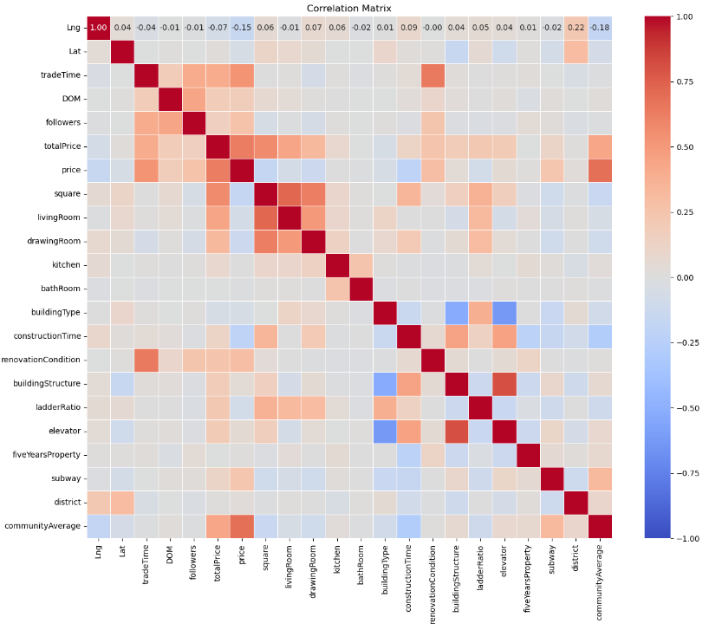
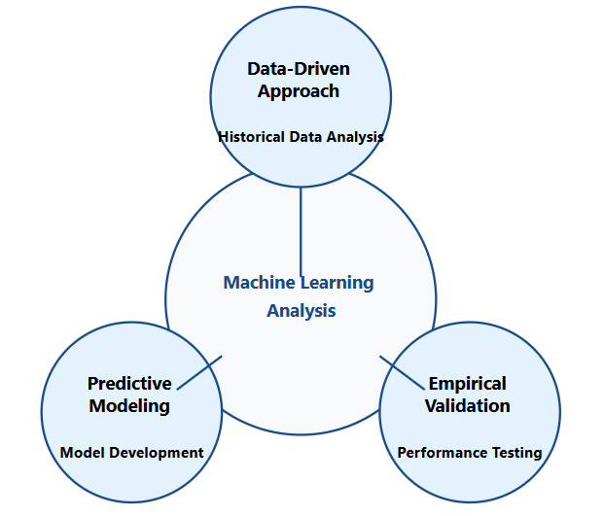
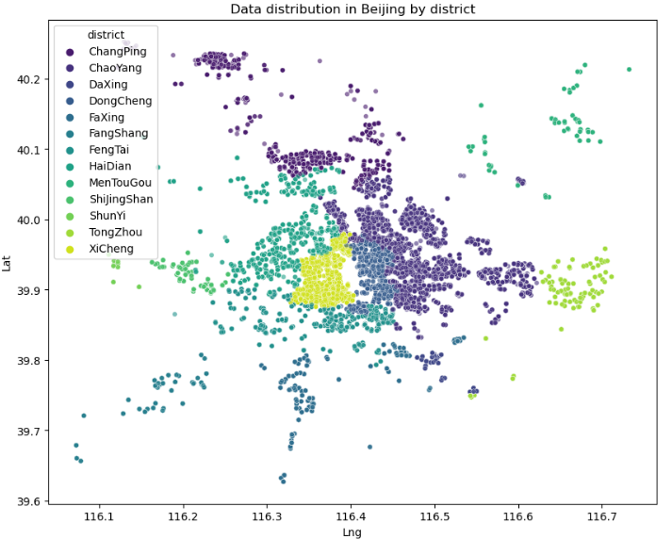
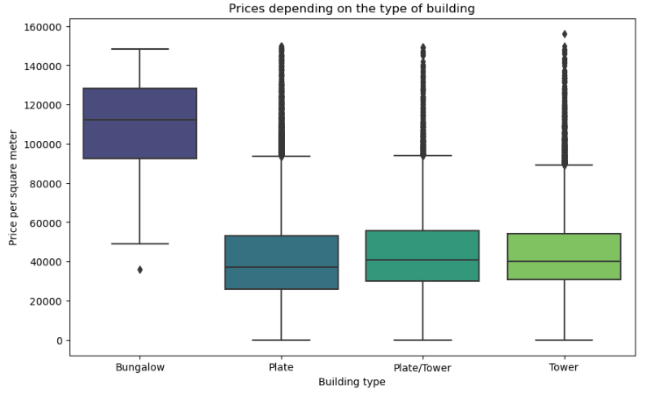
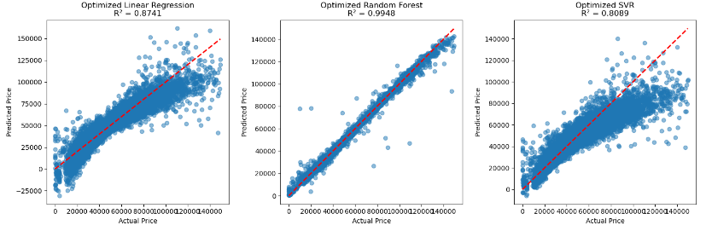
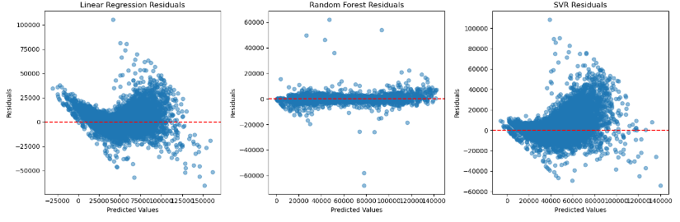
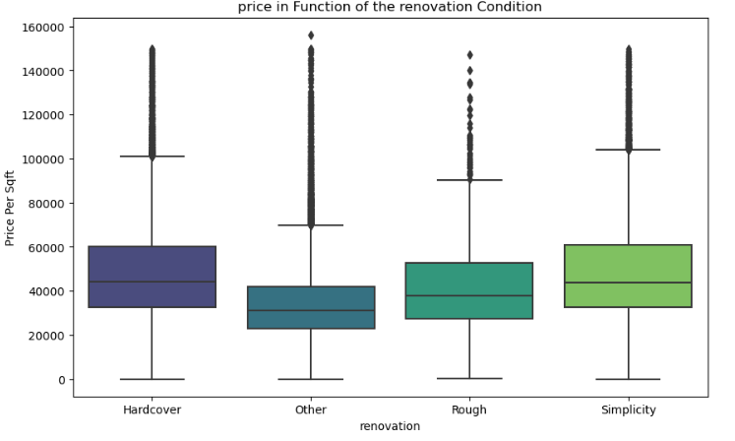
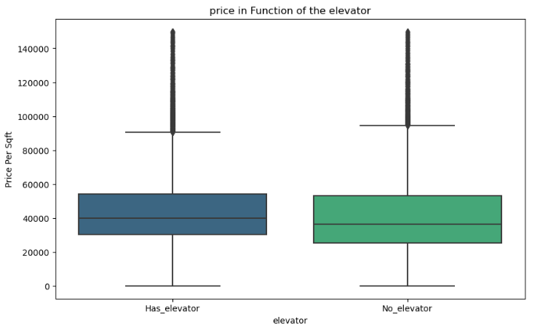
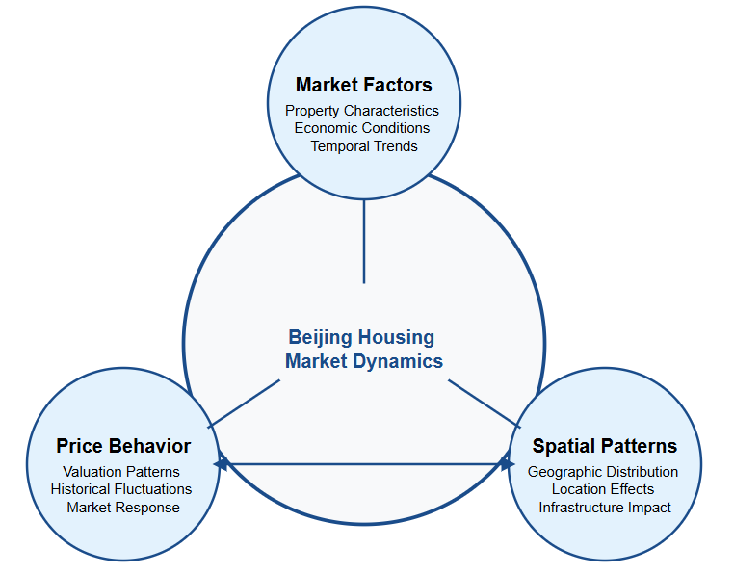
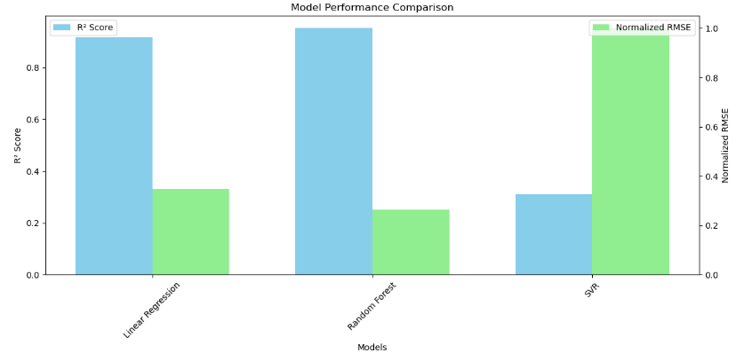
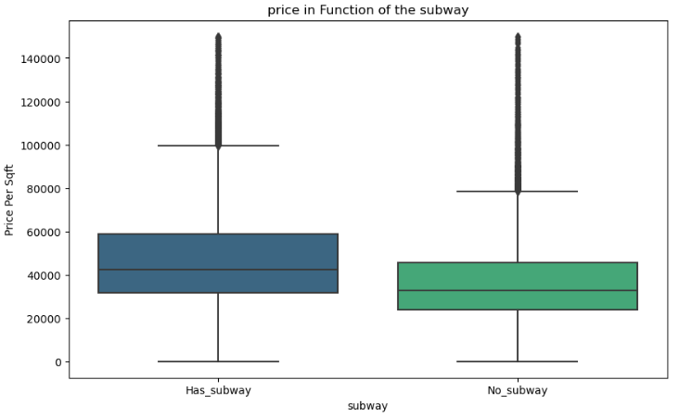
ANALYSIS OF BEIJING HOUSING MARKET TRENDS USING MACHINE LEARNING MODELS (2011-2017)
Derly Milded Montealegre Gonzalez | CCT College Dublin, November 2024
ABSTRACT
KEY HOUSING PRICE FACTORS
MODEL EVALUATION
DISTRICT ANALYSIS
This study analyzes Beijing's housing market through machine learning approaches, examining data from 2011-2017. The research focuses on developing predictive models to understand price dynamics and market trends, considering economic factors including the 6.1% growth rate observed in 2019.
Price Determinants
Modeling Technique Framework
The Beijing district research finds notable patterns in real estate distribution, with ChangPing, Chaoyang, and DongCheng having the highest concentration of activity. The results show a strong association between location and property valuation, with significant differences between central and outlying regions. Proximity to critical infrastructure and urban services is identified as a decisive element in price formation.
El The study used a quantitative-predictive technique to analyze complicated trends in the Beijing real estate market using advanced mathematical and statistical models. The figure below depicts the research paradigm, which can be defined as the systematic integration of data analysis, predictive modeling and empirical validation.
RESEARCH QUESTIONS
The correlation graph between numerical variables shows that the variables “living room”, “lounge”, “elevator” and “building structure”, among others, are represented by red dots and red derivatives that are close to the central red line. This suggests that these variables have a moderate correlation with each other and the central tendency line, indicating a consistent and significant relationship between them.
The three questions below represent the core focus of the entire study:
Q.1. What are the key factors influencing housing prices in Beijing?
Q.2. How effective are different ML models in predicting housing prices?
Q.3 What geographical patterns exist in the Beijing housing market?
Property Features
Performance Metrics
CONCLUSIONS
A summarised answer to the research questions are presented below:
Q.1. What are the key factors influencing housing prices in Beijing?
The analysis demonstrates that the physical attributes of the property have a considerable influence on prices, with the greatest values being the type of construction "Brick/Wood" and the presence of a lift. In addition, proximity to the metro is a deciding factor in the assessment.
Q.2. How effective are different ML models in predicting housing prices?
With an accuracy of 99.49%, the Random Forest model outperformed both Linear Regression (87.41%) and SVR (80.89%). The model's resilience is most visible in its capacity to manage a wide variety of prices and complex variables.
Q.3 What geographical patterns exist in the Beijing housing market?
ChangPing, Chaoyang, and DongCheng districts emerge as the most active real estate markets. The spatial study found distinct valuation patterns associated with location and access to urban infrastructure, resulting in a clear market segmentation by district.
CONCEPTUAL FRAMEWORK
This conceptual framework was created based on the dynamic interaction of three major components of Beijing real estate market. The interplay between Market Factors, Price Behaviour and Spatial Patterns serves as the foundation for machine learning-based predictive analysis, providing for a more complete understanding of the real estate market.
The Random Forest performs well with R² = 0.9948 and a margin of error of ±20,000 units, indicating great accuracy in the 20,000-140,000 range. Secondary models, Linear Regression (R² = 0.8741) and SVR (R² = 0.8089), perform well for medium-value attributes but fall short at extremes. Residue study validates Random Forest as the most trustworthy technique for the Beijing real estate market, particularly for high-value predictions.
Validation Results
REFERENCES
* Wu, J., Gyourko, J., & Deng, Y. (2016). Evaluating conditions in major Chinese housing markets. Regional Science and Urban Economics, 58, 12-25.
*Zhang, L., & Yi, Y. (2018). What drives housing markets: Fundamentals or bubbles? The Journal of Real Estate Finance and Economics, 56(3), 369-391.
* Housing price of Beijing from 2011 to 2017, fetching from Lianjia.com. Retrieved from: https://www.kaggle.com/datasets/ruiqurm/lianjia
Géron, A. (2022).
*Hands-On Machine Learning with Scikit-Learn, Keras, and TensorFlow: Concepts, Tools, and Techniques to Build Intelligent Systems (3rd ed.). O'Reilly Media.
*James, G., Witten, D., Hastie, T., & Tibshirani, R. (2021). An Introduction to Statistical Learning: With Applications in R (2nd ed.). Springer.
* Fang, H., Gu, Q., Xiong, W., & Zhou, L. A. (2016). Demystifying the Chinese housing boom. NBER Macroeconomics Annual, 30(1), 105-166.
Location Impact
The performance chart provides an interesting comparison of our three prediction models. Two metrics are used to evaluate each model: R², which measures accuracy, and RMSE, which measures error.
Random Forest stands out as the most effective model, with the greatest blue bar and the lowest green bar, indicating that it delivers very accurate predictions with minimum errors. Linear Regression has a great performance, with good accuracy and moderate errors, making it a dependable option.
Finally, the SVR model has the lowest performance. Although it achieves an adequate level of accuracy (blue bar), the large green bar suggests that its forecasts contain much more errors. This shows that, among the three approaches, SVR is the least recommended for this particular prediction instance.
The interaction between these three components provides a comprehensive understanding of how prices are determined in Beijing's real estate market, considering both physical aspects and location and market characteristics.

